Slide 1
errata
set http headers, request URLs, ServeFile

Slide 2
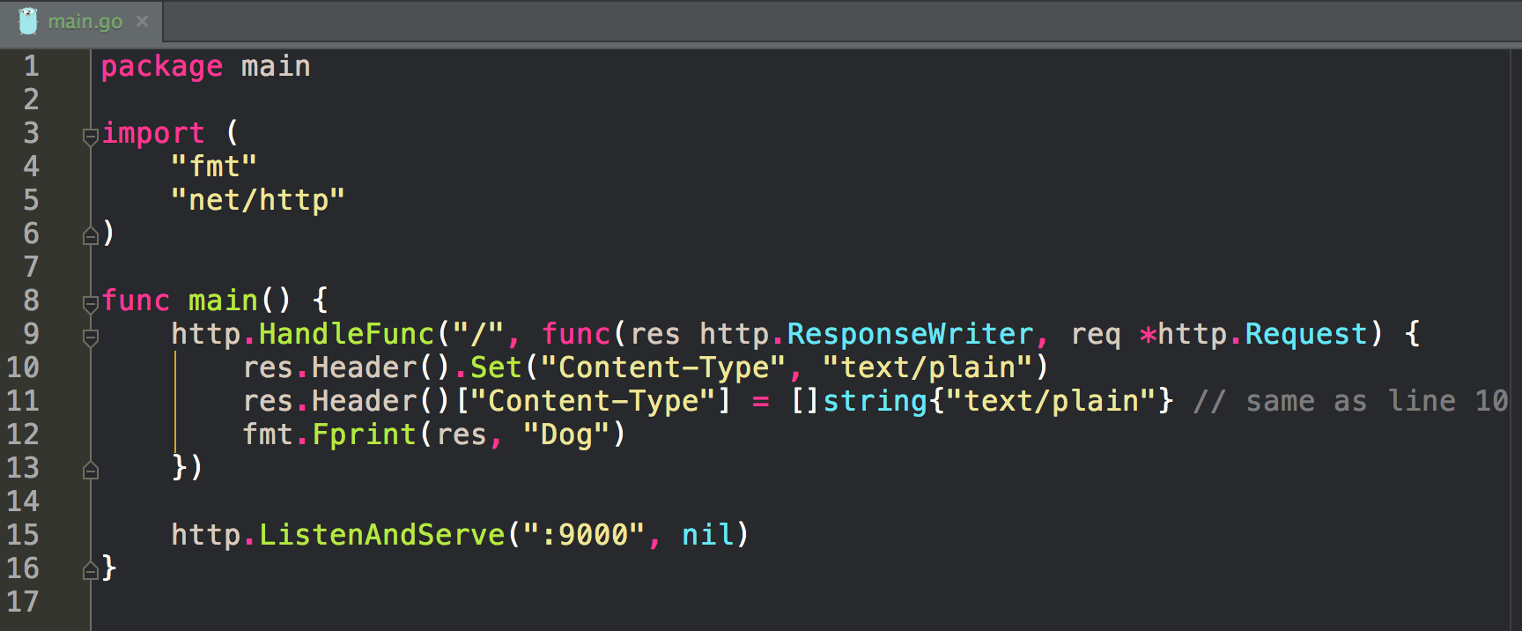
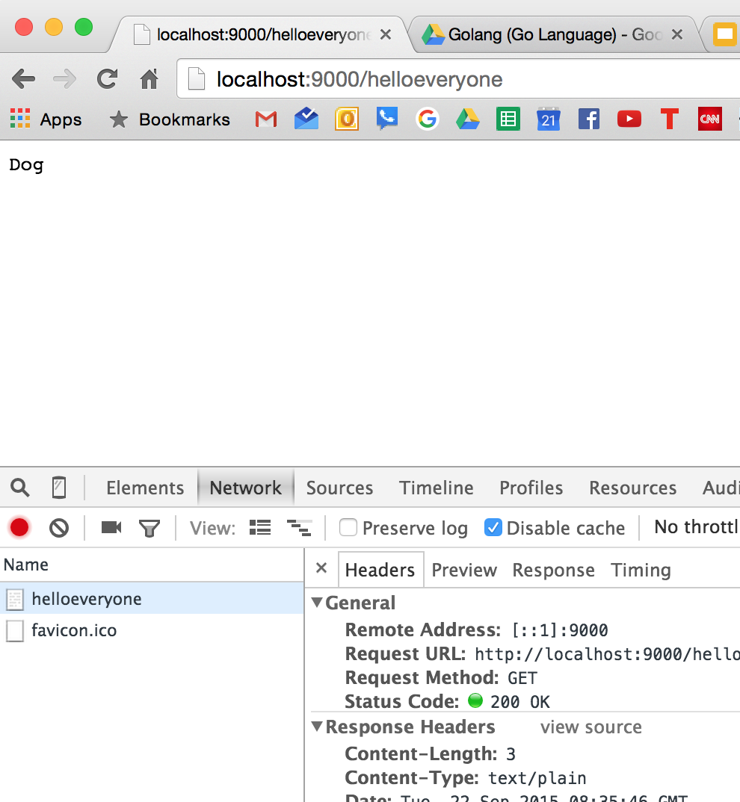
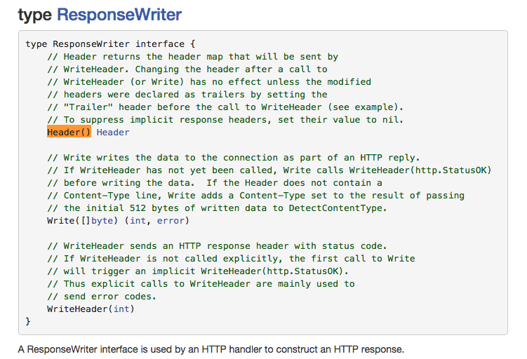
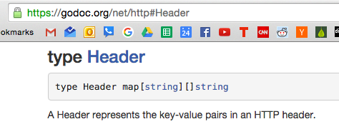
not a good way to do it, though

Slide 3
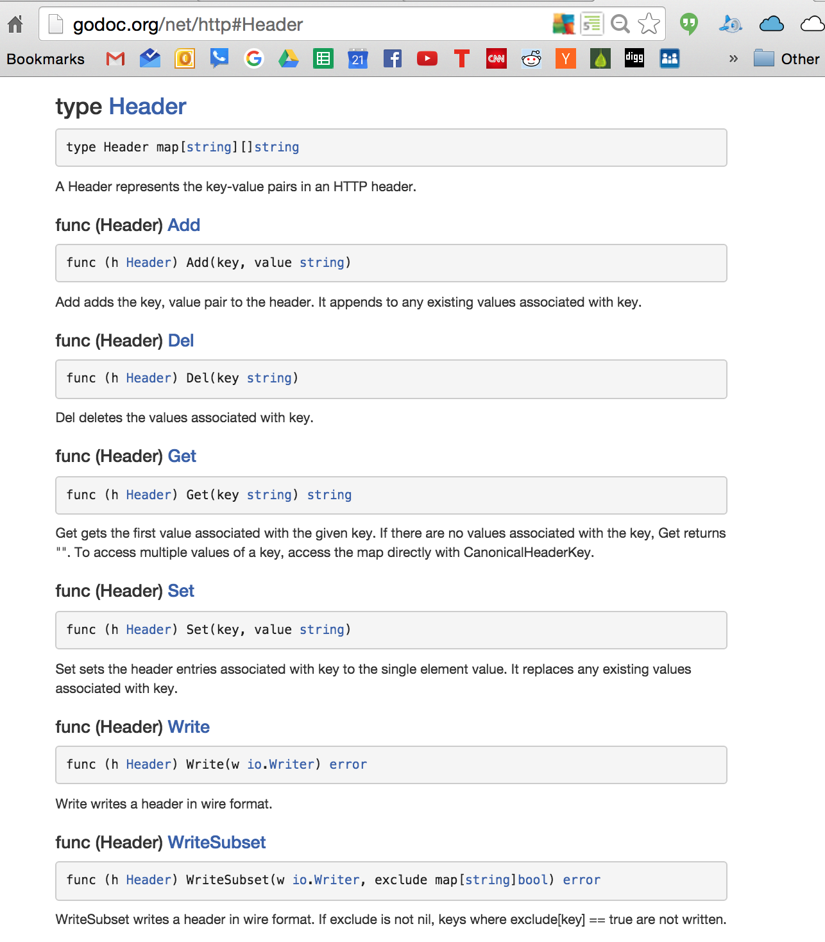

Slide 4
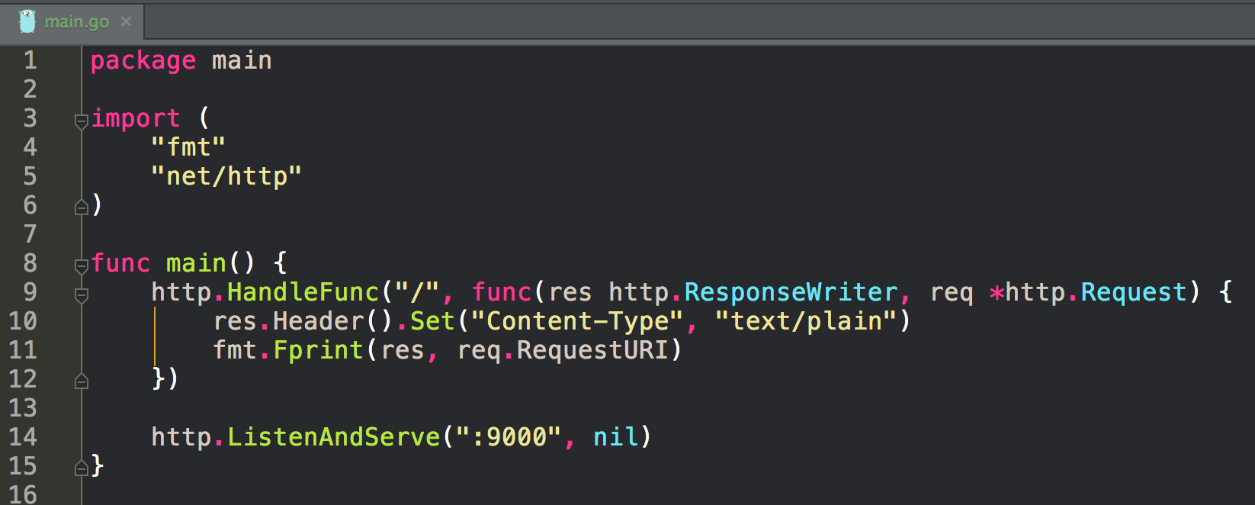
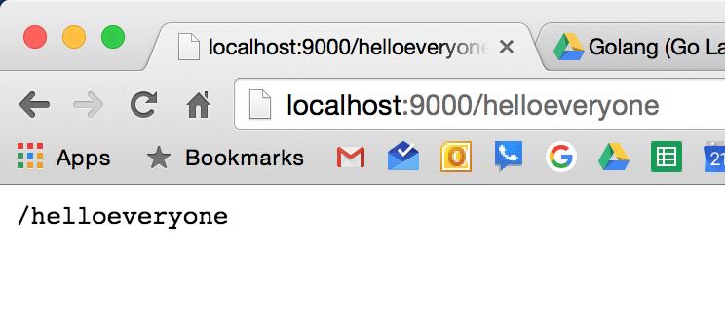

Slide 5
http://godoc.org/net/http#Request

Slide 6
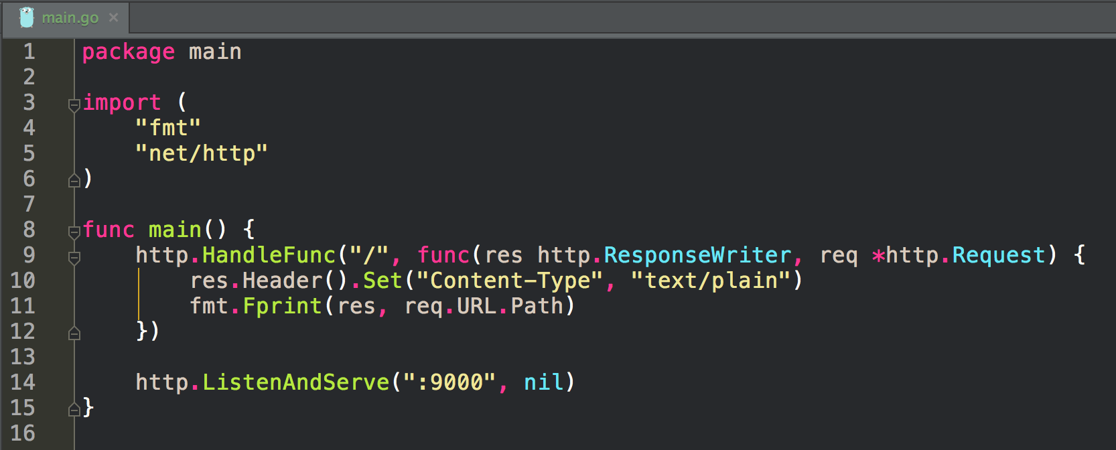
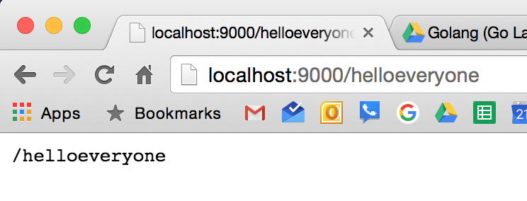

Slide 7
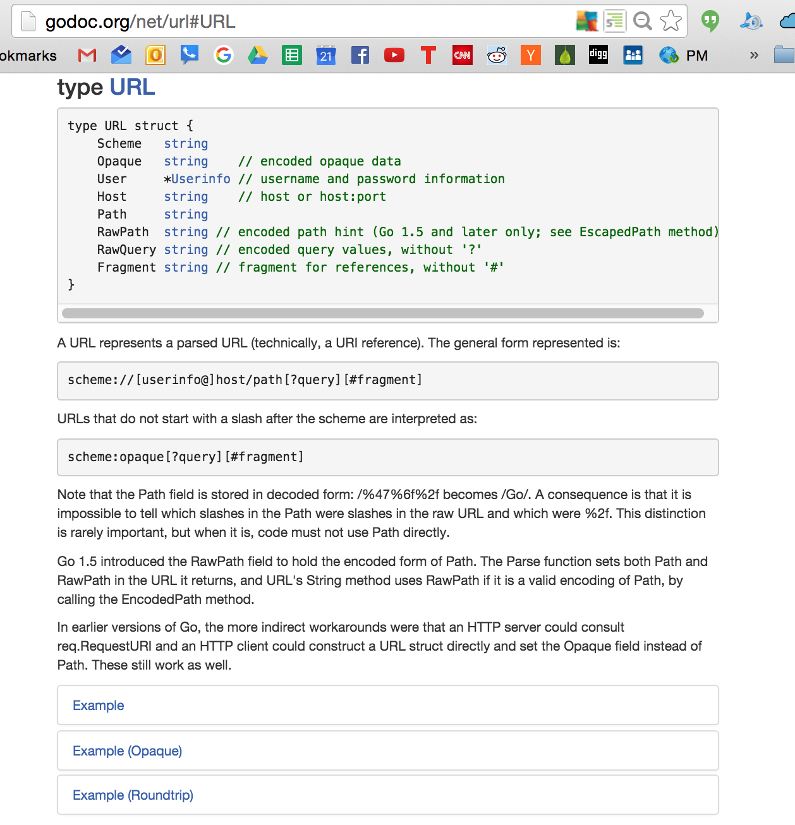

Slide 8
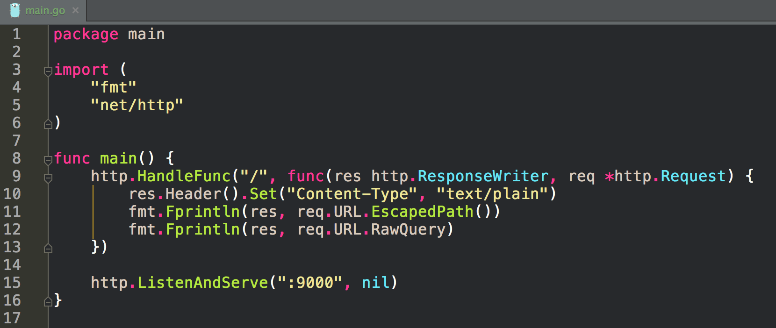
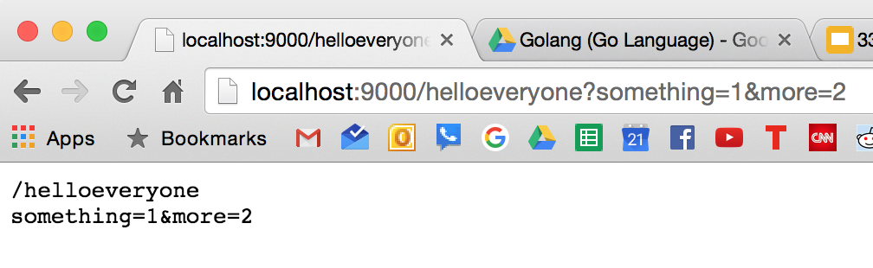

Slide 9
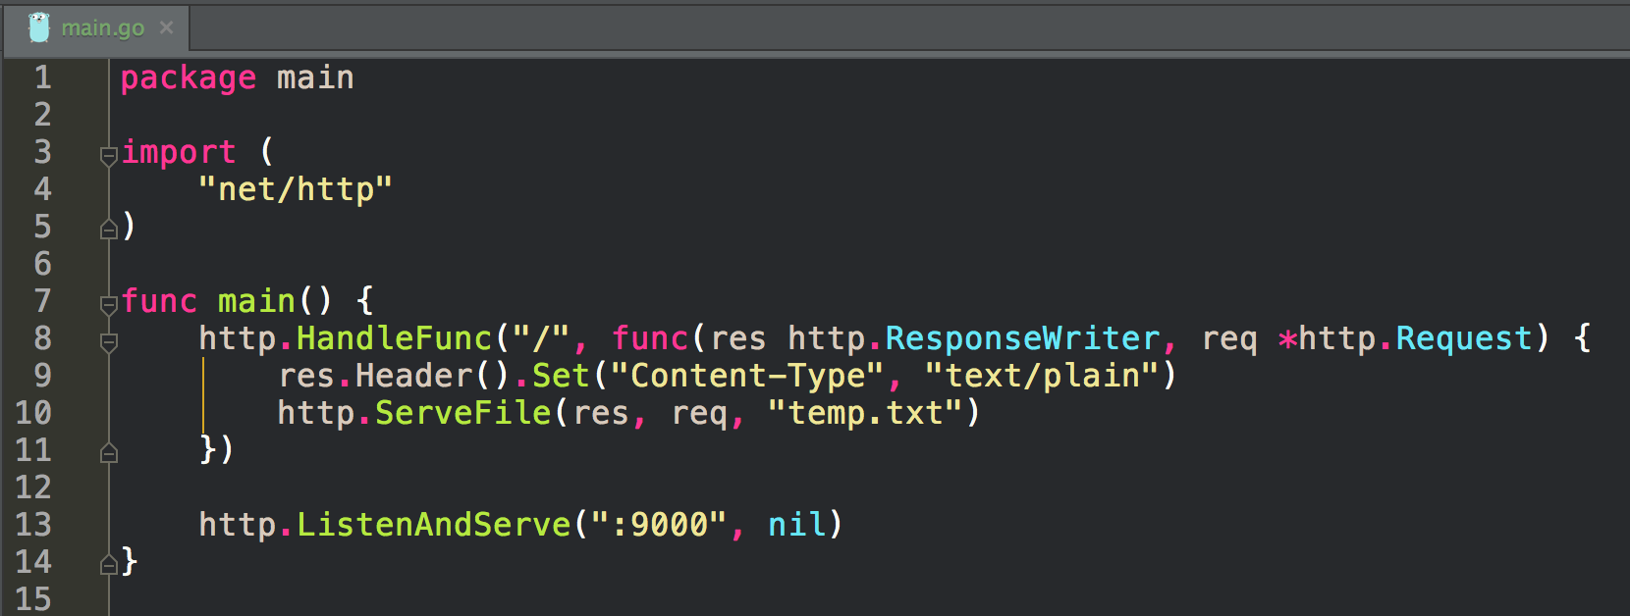
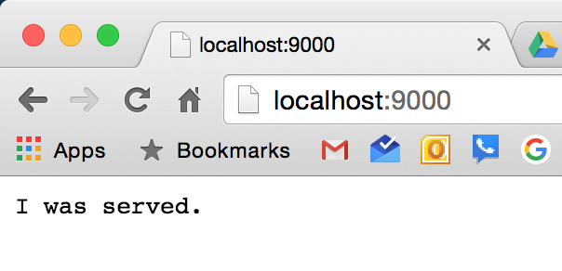
When you compile your program, the files and folders to serve don’t get compiled with it. You need to run your binary from a folder location relative to the files it is going to access. For instance, in a previous example we had an assets folder. We would need our binary to run from a folder that had that assets folder.
FYI, go-bindata will generate go code of files: creates a giant byte slice of a file and embeds it in the binary

